Slide 1
Making Space to ACT: Supporting Parents with Resistant Teens
K. Alice Cennamo, LCSW, LCAS
Kevin Waller, MA, NCC, LCMHCS, LCAS, CCS

Slide 2
Alice Cennamo
K. “Alice” Cennamo, LCSW LCAS, is a wilderness therapist at Blue Ridge Therapeutic Wilderness, working with adolescent females as they move through problematic substance use, trauma, family conflict, and co-occurring disorders. She utilizes a strength-based approach in her work with adolescents and emphasizes empowerment as an agent for creating change.

Slide 3
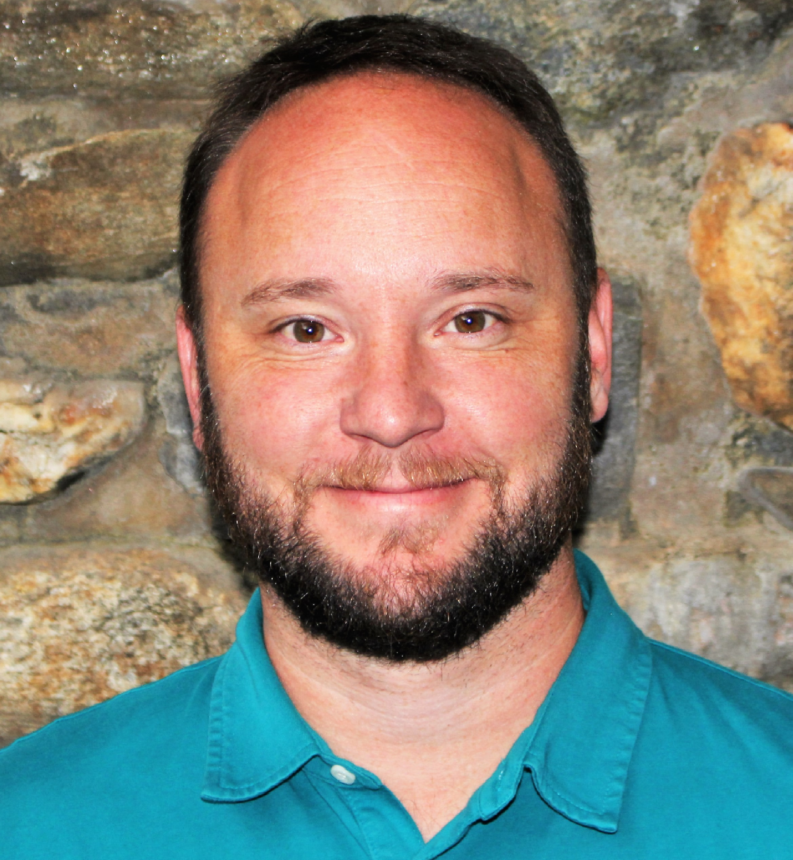
Kevin Waller
Kevin Waller, MA, NCC, LCMHCS, LCAS, CCS works as the Family Program Manager at SUWS of the Carolinas which is located outside of Asheville North Carolina. He has spent the past 18+ years working with adolescents and their families in wilderness settings while navigating challenges such as problematic substance use, anxiety, trauma, learning differences etc.. His clinical focus consists of ACT, RFT, MI, and Systemic Family Therapy.

Slide 4
Disclosures
Alice Cennamo
I have not received and will not receive any commercial support related to this presentation or the work presented in this presentation.
Kevin Waller
I have not received and will not receive any commercial support related to this presentation or the work presented in this presentation.

Slide 5
Objectives
1. Participants will be able to recognize family system accommodations and their role within experiential avoidance
2. Participants will be able to apply tools for supporting parents in understanding the function of their and their children’s behavior
3. Participants will be able to teach and role model sitting with discomfort through practicing stress cycle completion skills
Notes:
Kevin
Give overview of presentation, introduce SPACE overlaid with ACT, relate content to lens of clinician as well

Slide 6
Case Study
Sally & John are recently separated parents, with two children. They are arriving to treatment seeking guidance on managing their daughter’s behaviors. Their daughter, Lucy, is a 15yo with anxiety, a recent suicide attempt, depression, substance use, and high family conflict. They are hoping to target Lucy’s anxious behaviors, most notably: intense distress about sleeping alone; frequent cannabis use; school avoidance, refusal, or early dismissal; suicide attempts and threats; and frequent emotional outburst when she hears the word “no.”
Notes:
Google search, family system, boundaries
Kevin
Could easy be a presentation about working with Lucy’s anxiety, but different perspective is working with PARENTS behaviors on lucy’s anxiety

Slide 7
SPACE
Supportive Parenting for Anxious Childhood Emotions, Eli Lebowitz, Ph.D.
Short term (12 sessions) intervention to help children navigate problematic anxiety
Primary Target is Child’s ability to manage anxiety
Intervention focus on parents behavior
Support (acceptance/validation + confidence = support)
Accomodations
Notes:
Kevin
Treatment for parents for child anxiety, why? Systematic nature of anxiety, helps to minimize/reframe parental blame, focus on short term committed action around self awareness/self-control vs controlling child bx
Psycho ed @ anxiety, personal boundaries, look at accommodation and support
Formula- intro, increasing support, charting accommodation, choosing target, making plan, informing child, implementation, additional targets

Slide 8
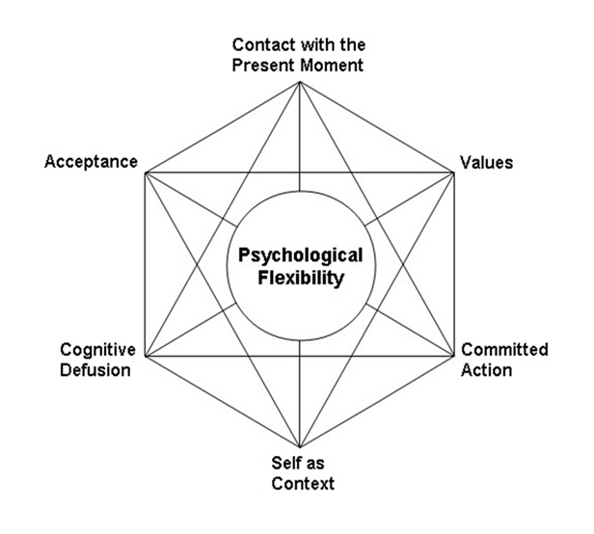
ACT
Be Present
Open Up
Do What Matters
Notes:
Alice

Slide 9
Case Study cont.
Lucy’s parents report picking her up from school or allowing her to stay home from school 1-3 times a week. If her parents set the boundary to not pick her up from school, she threatens suicide or skips school with friends. She reports that vaping THC is the only thing that helps calm her anxiety. Parents tried to enforce a no drug use policy, but eventually were worn down to no drug use in the house. Due to Lucy’s anxiety, she is emphatic that either mom or a friend has to sleep in the same room as her.
Notes:
Lucy’s parents report picking her up from school or allowing her to stay home from school 1-3 times a week. If her parents set the boundary to not pick her up from school, she threatens suicide or skips school with friends. She reports that vaping THC is the only thing that helps calm her anxiety. Parents tried to enforce a no drug use policy, but eventually were worn down to no drug use in the house. Due to Lucy’s anxiety, she is empahtic that either mom or

Slide 10
How much of my time is taken over by my child’s anxiety?
What am I doing different for this child compared to his/her siblings?
What would I do differently if my child was not anxious or afraid?
Notes:
Motivate/become aware that change is necessary for parents within the SPACE model

Slide 11
Accommodation
Action doing or not doing because of the child’s anxiety
Often serves the function of avoidance
Goal of an accommodation is to avoid the child’s avoidant behaviors
Intervention is with parents behavior
Notes:
Kevin– EXPERIENTIAL
“Distress related to the disorder” = “name the behavior”
Name accommodation cycle
Normalize - children - fear is a social response, anxiety dx - chronic inappropriate activation of the fear response, child anxiety- chronic inappropriate activation of the social signaling system of fear
Then for parents try to help/ alleviate anxiety exacerbates the anxiety leading to more severe anxiety symptoms in child and family, predicts poor tx outcomes and leads to additional problems
FASA? Family accommodation scale anxiety
What is it, function, derived relations RFT
What kids say, are accommodations helpful in short run- yes, are helpful in long run- no, should parents stop accom- never
fusion/ stories tell self “my job is to protect”- they can’t do it/ handle it, a b or c will happen if…, and “my job is to promote independence” they should be able to handle it, it’s not that bad, just get over it and move on

Slide 12
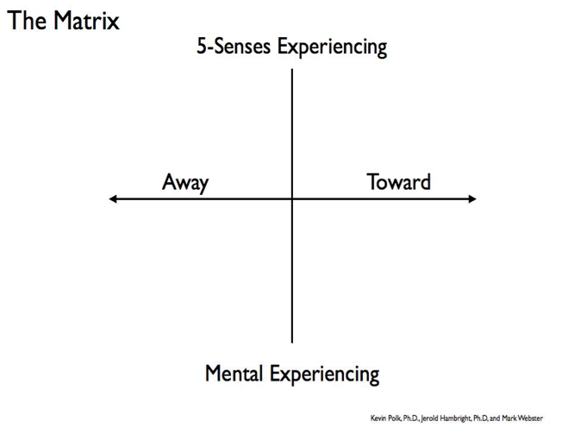
Accommodations in case study
Parents picking Lucy up from school repeatedly
Parents talking to the teachers about missed school work
Parents setting up doctors appointments after doctors appointments
Parents have tried multiple audio-visual supports and medications
Parents have pulled an additional mattress into their bedroom
Parents have allowed friends to stay over most nights
Parents have allowed Lucy to vape THC
What else…
Notes:
Alice- matrix clicked in later
Specific

Slide 13
Connecting SPACE & ACT
Behaviors and accommodations within the context of Workability
Accommodations = Experiential Avoidance
Values work = how to show up in the face of our own & our children’s suffering (and our client’s suffering!)
Accommodations are not “BAD”- functional contextualism
One accommodation at a time = Committed Action
Notes:
Alice- reference case study– where to start?
Workability, context sensitivity/functional contextualism, values driven choices vs. experientially avoidant behaviors, not all accommodations are bad,

Slide 14
Notes:
Alice– write in what we would want to happen there (values, defusion, acceptance, etc)
How to change the accommodation
Supportive statements
Compassionate boundaries
Acceptance of what comes up in the process
Emotions
Additional behaviors
Self-compassion
acceptance of function of behavior
Normalize & Accept– Functional Contextualism
Workability
Values & Why it’s worth it
Defuse
Start small, pick one behavior (committed action)

Slide 15
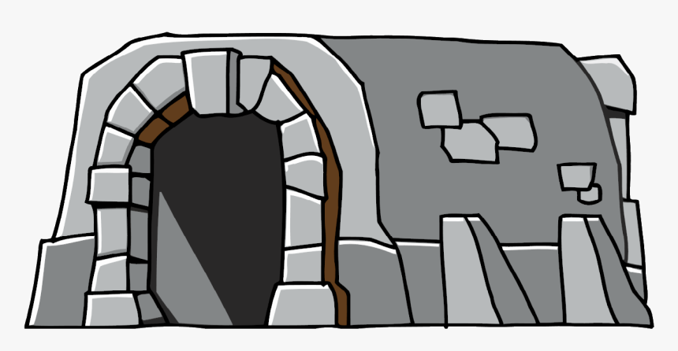
Moving through stressful emotions
7 ways to complete the stress cycle by using the language of the body:
Physical activity
Breathing
Positive social interaction
Laughter
20 Second Hug; 6 second kiss
Crying
Creative expression
Notes:
Alice
Rest?

Slide 16
For the helping professional
We helpers accommodate, too!
What are ways we knowingly/unknowingly accommodate our clients?
Completing the stress cycle & moving through stressful emotions ourselves
Role modeling & supervision
Notes:
List common accommodations, co-soothing, minimizing, avoiding triggers and tough emotions, being friends, advice giving,

Slide 17
References & Resources
Notes:
Add FASA
SPACE
Russ Harris
Lebowitz, Eli R. PhD, Breaking Free of Child Anxiety and OCD: A Scientifically Proven Program for Parents, 2021

Slide 18
Questions & Final Thoughts
Kevin Waller
Kevin.Waller@Suwscarolinas.com
Alice Cennamo
AliceC@blueridgewilderness.com
Notes:
Alice

